Slide 1

DRUG RECOMMENDATION SYSTEM BASED ON SENTIMENT ANALYSIS OF DRUG REVIEWS USING MACHINE LEARNING
SUBMITTED BY (BATCH -7) :
Ch. K N M Dattathreya 19NG1A0568
N. Sai Sekhar 19NG1A05A0
V. Akanksha 19NG1A05B9
R.Ramya Sri 19NG1A05A5
Under the Guidance of
B V. Praveen Kumar
Asst. Prof
Department of Computer Science and Engineering

Slide 2
Contents
INTRODUCTION
EXISTING SYSTEM
PROPOSED SYSTEM
SYSTEM REQUIREMENTS
ALGORITHM AND METHODOLOGIES
SYSTEM ARCHITECTURE
FLOW CHART
INPUT & OUTPUT
CONCLUSION
Department of Computer Science and Engineering

Slide 3
INTRODUCTION:
Medicine is the field of health and healing. It includes nurses, doctors, and various specialists. It covers diagnosis, treatment, and prevention of disease, medical research, and many other aspects of health.
Every day a new study comes up with accompanying more drugs, tests, accessible for clinical staff every day.
But there will be a shortage of doctors, particularly in rural areas where the quantity of specialists is less compared to urban areas.
Thus, the number of doctors can’t be expanded quickly in a short time frame.
Accordingly, it turns out to be progressively challenging for doctors to choose which treatment or medications to give to a patient based on indications, past clinical history.
Department of Computer Science and Engineering

Slide 4
EXISTING SYSTEM
In the current healthcare system, doctors and pharmacists typically rely on clinical trials, drug labels, and their own expertise to recommend drugs to patients.
However, these methods do not always take into account the patient's individual experiences and preferences.
In the existing work, the system did not implement an exact sentiment analysis for large data sets.
Department of Computer Science and Engineering

Slide 5
DISADVANTAGES OF EXISTING SYSTEM
In the existing work, the system did not implement an exact sentiment analysis for large data sets.
Limited Data Sources.
Language Barriers.
Limited Accuracy:
Department of Computer Science and Engineering

Slide 6
PROPOSED SYSTEM
The proposed system leverages machine learning algorithms and sentiment analysis techniques to analyze patient reviews of drugs and provide personalized drug recommendations based on the patient's sentiments and experiences.
The system uses natural language processing (NLP) techniques to extract relevant features such as drug efficacy, safety, and side effects from the patient reviews.
The proposed system has the potential to provide personalized and effective drug recommendations to patients based on their past experiences and sentiments shared in drug reviews.
The extracted features are then used to train a sentiment analysis model that can classify the reviews as positive, negative, or neutral.
Department of Computer Science and Engineering

Slide 7
ADVANTAGES OF PROPOSED SYSTEM
The system is more effective since it presents the proposed algorithm used in natural language processing responsible for counting the number of times of all the tokens in review or document.
Personalized Recommendations that it takes into account the patient's medical history, age, gender, and other factors to provide tailored recommendations.
Performance will be Enhanced.
Improve patient outcomes, reduce healthcare costs, and provide valuable data-driven insights for healthcare providers.
Department of Computer Science and Engineering

Slide 8
SYSTEM REQUIREMENTS
HARDWARE REQUIREMENTS:
System : i3 Processor.
Hard Disk : 500 GB.
Monitor : 15’’ LED
Input Devices : Keyboard, Mouse
Ram : 4 GB
SOFTWARE REQUIREMENTS:
Operating system : Windows 10.
Coding Language : Python 3.8
Web Framework : Flask
Department of Computer Science and Engineering

Slide 9
ALGORITHM
RNN Bidirectional
It is a variant of recurrent neural network (RNN) that is used for natural language processing (NLP) tasks, such as sentiment analysis. The algorithm processes input sequences in both directions, from the beginning to the end and from the end to the beginning.
The algorithm processes the review text as a sequence of words and learns to identify positive, negative, or neutral sentiment associated with each word in the sequence.
The system uses a collaborative filtering approach to recommend drugs to users based on their preferences and the sentiment analysis of the reviews.
Overall, the RNN Bidirectional algorithm is an important component of the drug recommendation system, as it enables the system to extract sentiment information from drug reviews and provide more accurate and personalized recommendations to users.
Department of Computer Science and Engineering

Slide 10
METHODOLOGIES
DATA CLEANING AND VISUALISING
FEATURE EXTRACTION
BOW(Bag Of Words)
TF-IDF(Term Frequency Identification)
WORD2VEC(Words to Vectorization)
Department of Computer Science and Engineering

Slide 11
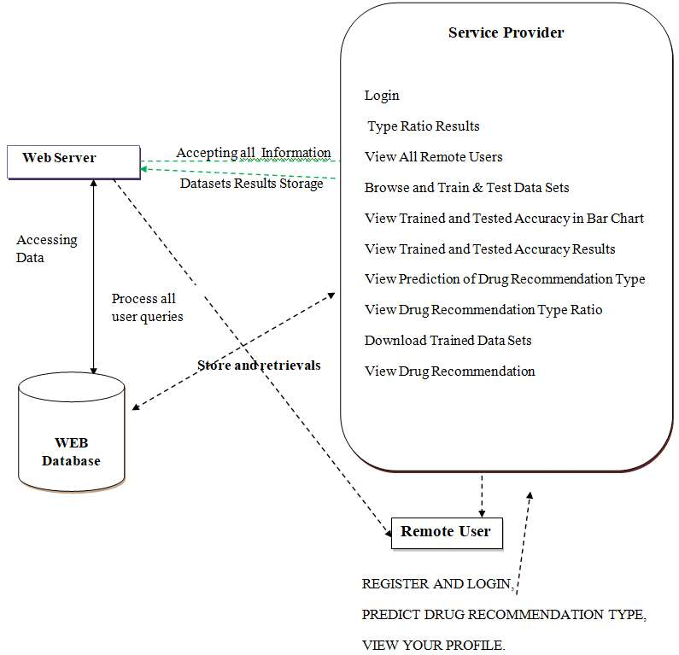
SYSTEM ARCHITECTURE
Department of Computer Science and Engineering

Slide 12
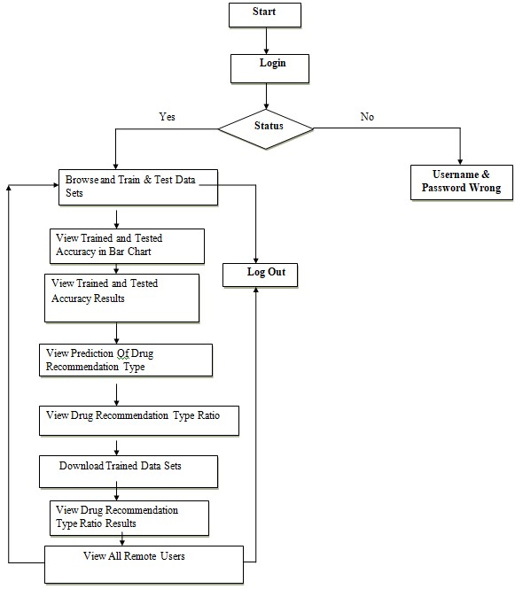
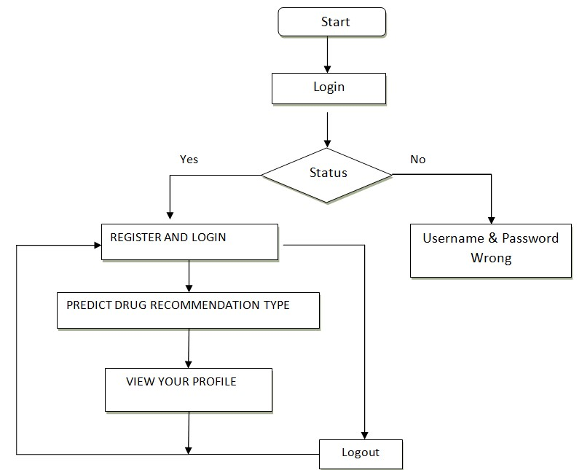
FLOW CHART
For service provider
For Remote user
Department of Computer Science and Engineering

Slide 13
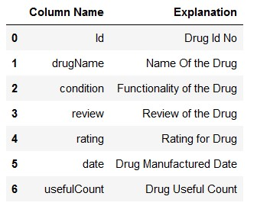
Input
Department of Computer Science and Engineering

Slide 14
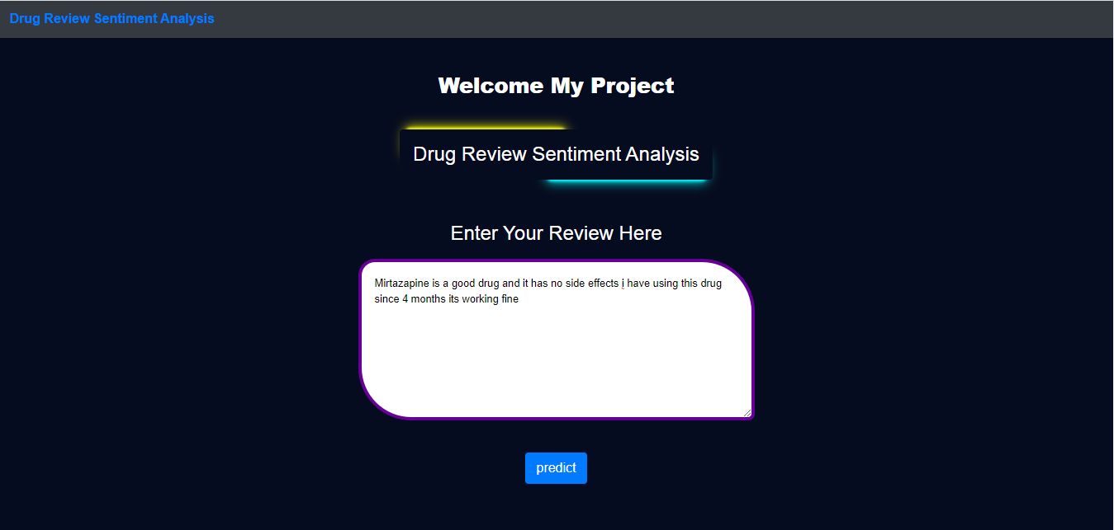
Output
Department of Computer Science and Engineering

Slide 15
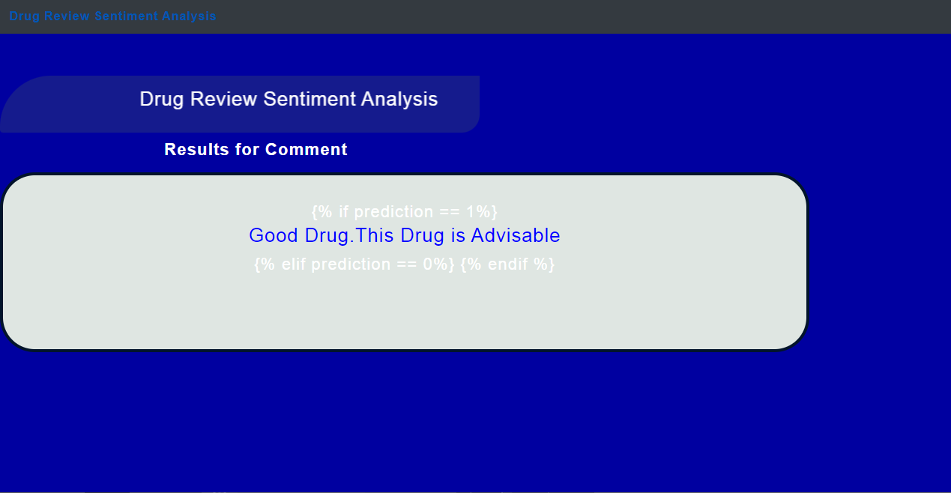
Output
Department of Computer Science and Engineering

Slide 16
CONCLUSION
Reviews are becoming an integral part of our daily lives; whether go for shopping, purchase something online or go to some restaurant, we first check the reviews to make the right decisions.
Motivated by this, in this research sentiment analysis of drug reviews was studied to build a drug recommender.
Future work involves comparison of different oversampling techniques, using different algorithms and optimization of algorithms to improve the performance of the recommender system.
Department of Computer Science and Engineering

Slide 17
THANK YOU
Department of Computer Science and Engineering

